Slide 1

Welcome
A Presentation on
Attendance Monitoring System by Face Recognition using Deep Learning Technology and Computer Vision
Semester: Spring 2021-22

Slide 2
Supervised by
Dr. Debojyoti Karmaker
Associate Professor
Department of Computer Science
American International University-Bangladesh
Group Members
IHSAN MD. AL AQIB 18-37074-1
MD. SAKIBUL ALAM UTCHAS 18-37079-1
S.M. IRAMUL MURSHED 18-37069-1
HASEBUL HASAN SHIHAB 18-37031-1

Slide 3
Agenda
introduction
related works
cnn layers
model
result
limitations
future work
The background of the study
Theoretical aspects of our study
Discussing the different layers of cnn
Discussing the model of the study
Discussing the findings of the study
Limitations of the model
future scope

Slide 4



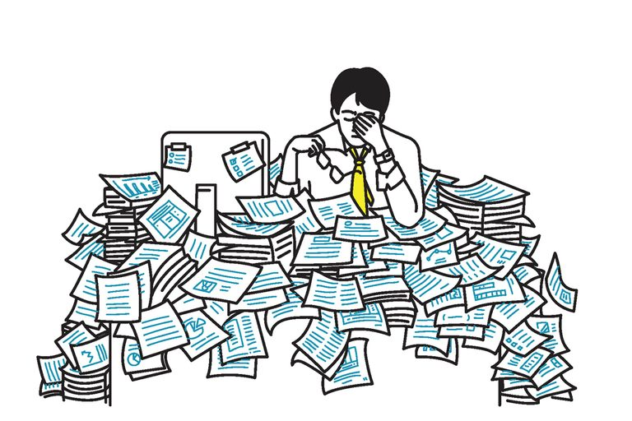
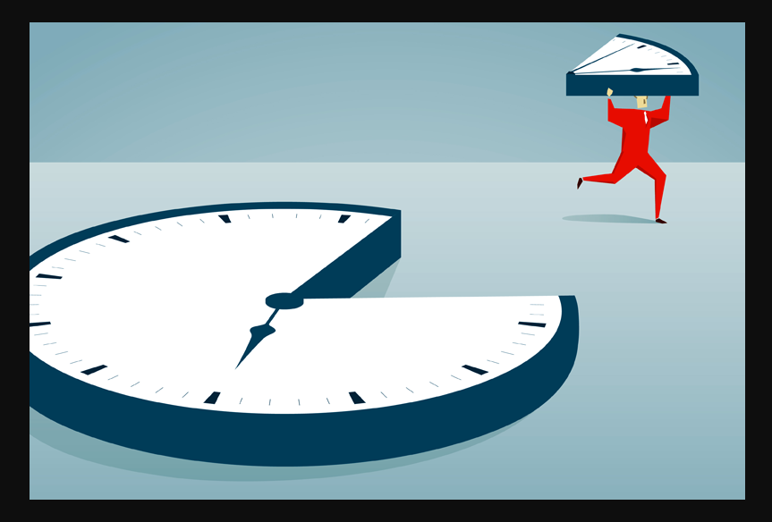

related work
model
introduction
future work
limitations
result
cnn layers

Slide 5
related work
model
introduction
future work
limitations
result
cnn layers
Group Members
MD. MUZAKKER HOSSAIN 18-37801-2
ZAHIN AWOSAF 18-37064-1
MD. SALMAN HOSSAN PROTTOY 18-36902-1
ABU SALEH MUHAMMOD ALVY 18-37487-1

Slide 6
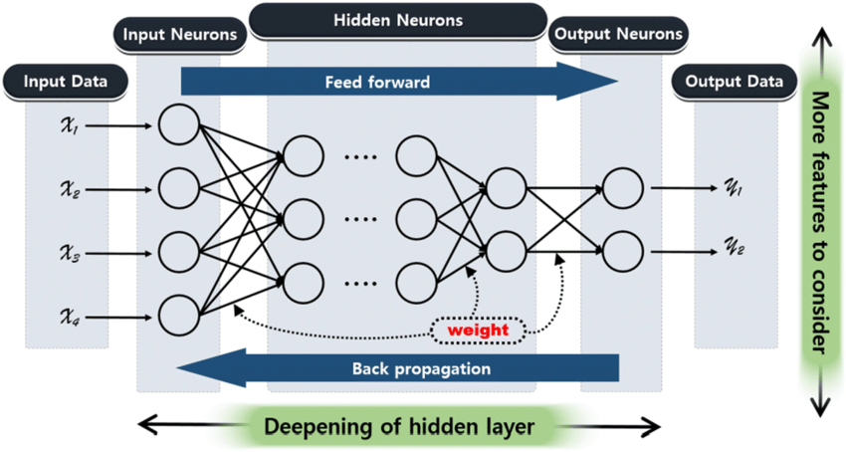
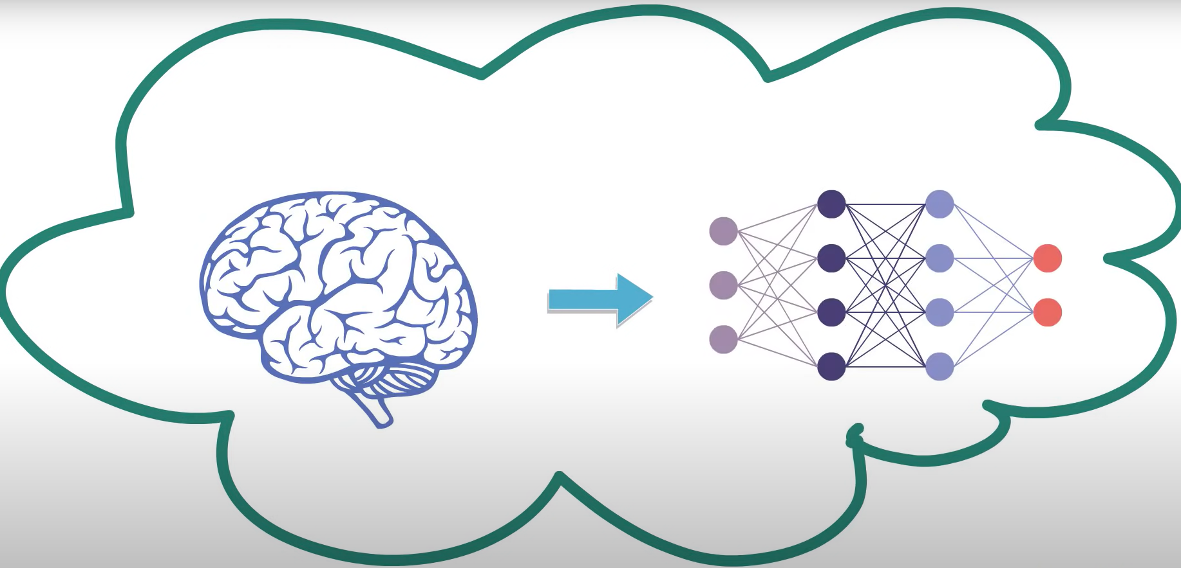
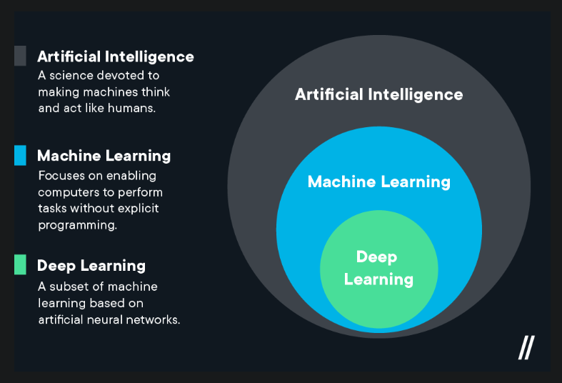
related work
model
introduction
future work
limitations
result
cnn layers

Slide 7
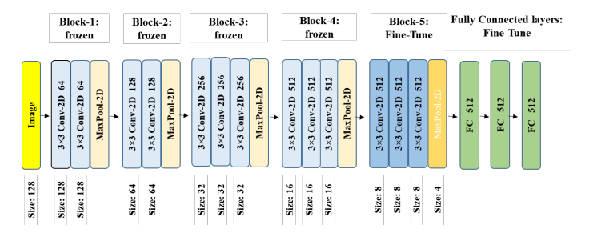
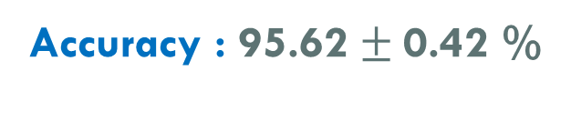
Using Siamese Networks with Transfer Learning for Face Recognition on Small-Samples Datasets
Model : Siamese-VGG
Dataset Used : LFW dataset
model
Contains over 13000 facial images of 1680 individuals.
Coloured images with image size 250 X 250.
related work
future work
introduction
limitations
result
cnn layers
Group Members
MD. MUZAKKER HOSSAIN 18-37801-2
ZAHIN AWOSAF 18-37064-1
MD. SALMAN HOSSAN PROTTOY 18-36902-1
ABU SALEH MUHAMMOD ALVY 18-37487-1
Accuracy : 95.62 $±$0.42 %
Fig. : VGG-16 with fully connected layers on top for fine-tuning.

Slide 8
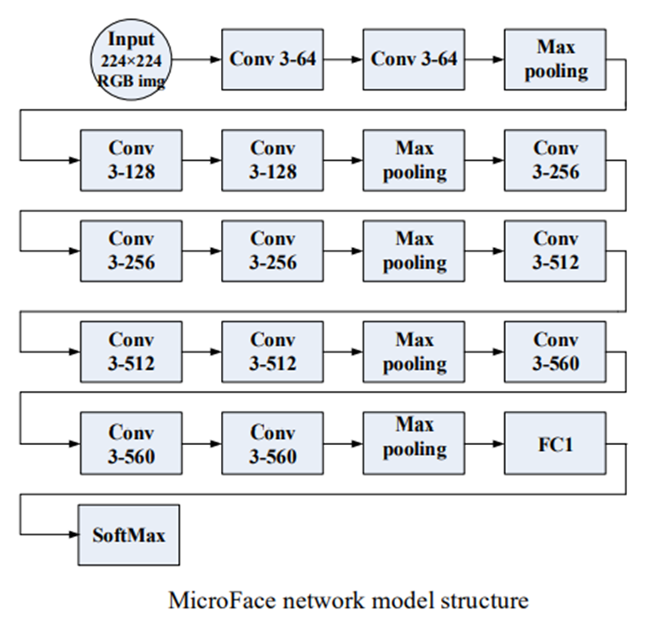
Face recognition based on improved VGGNET convolutional neural network
Model : MicroFace (VGG-16 Based)
Dataset Used : CASIA WebFace
model
related work
future work
introduction
limitations
result
cnn layers
Contains 500000 images of 10575 people.
Coloured images with image size 224 X 224.
Group Members
MD. MUZAKKER HOSSAIN 18-37801-2
ZAHIN AWOSAF 18-37064-1
MD. SALMAN HOSSAN PROTTOY 18-36902-1
ABU SALEH MUHAMMOD ALVY 18-37487-1
Accuracy : 96.26%

Slide 9
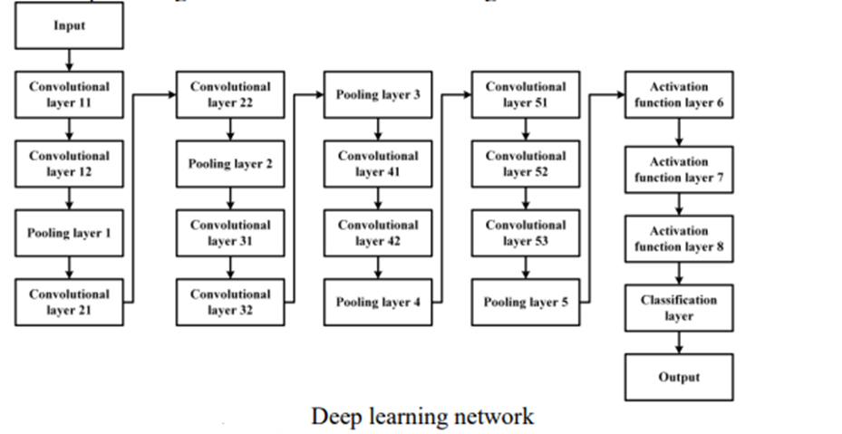
Face Recognition Algorithm Based On Convolutional Neural Network
Model : CNN
model
Dataset Used : CASIA WebFace
related work
future work
introduction
limitations
result
cnn layers
Group Members
MD. MUZAKKER HOSSAIN 18-37801-2
ZAHIN AWOSAF 18-37064-1
MD. SALMAN HOSSAN PROTTOY 18-36902-1
ABU SALEH MUHAMMOD ALVY 18-37487-1
Contains 494414 images of 10575 people.
100×100×1 grayscale image.
Accuracy : 98.78%

Slide 10
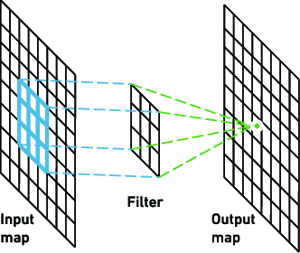
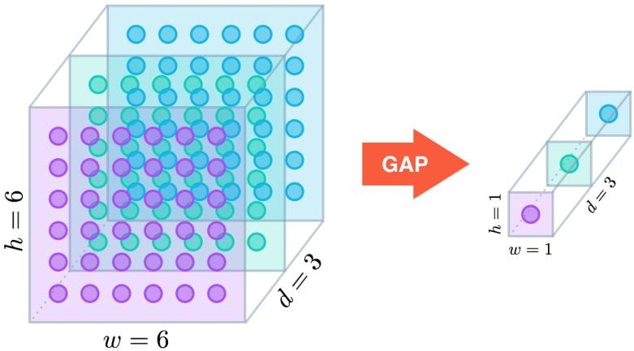
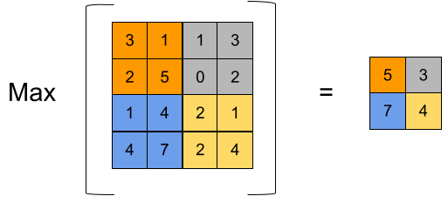
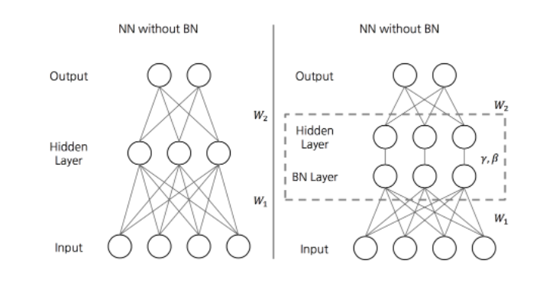
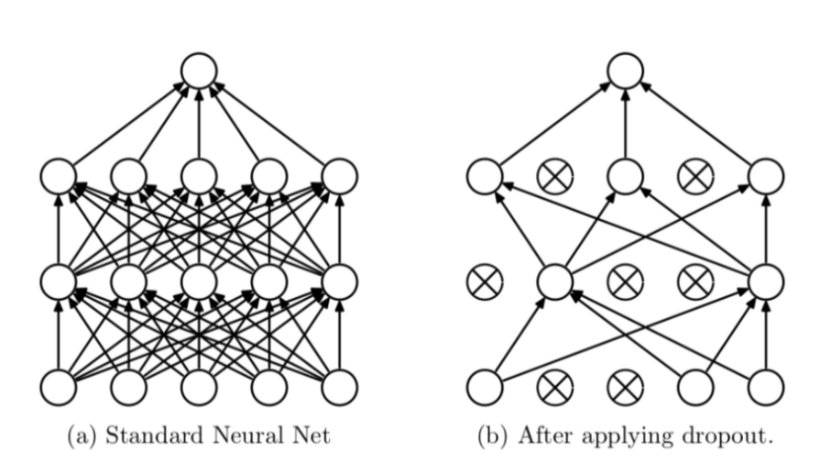
Convolutional layer
model
related work
future work
introduction
limitations
cnn layers
result
Group Members
MD. MUZAKKER HOSSAIN 18-37801-2
ZAHIN AWOSAF 18-37064-1
MD. SALMAN HOSSAN PROTTOY 18-36902-1
ABU SALEH MUHAMMOD ALVY 18-37487-1
Global Average Pooling
Max Pooling
Batch normalization
Dropout

Slide 11
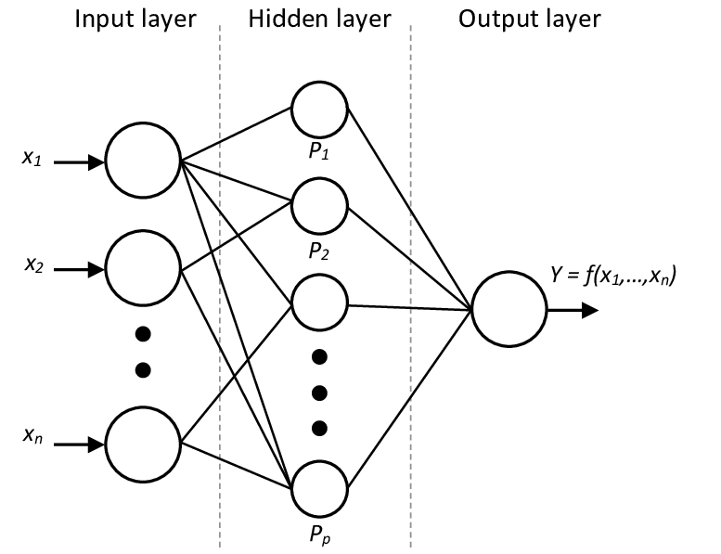
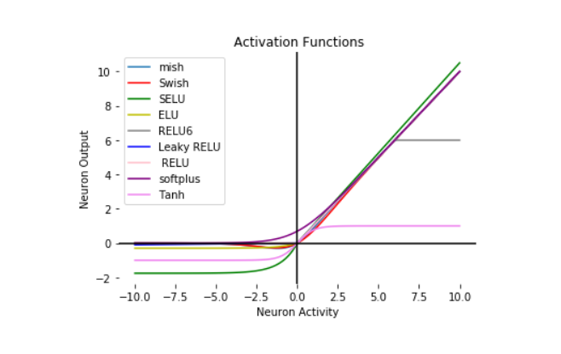
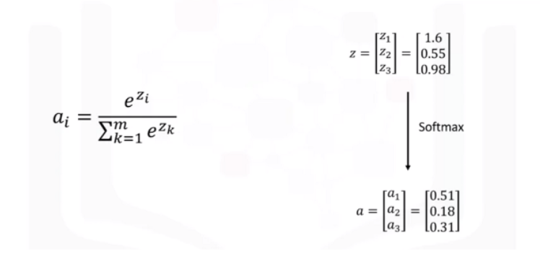
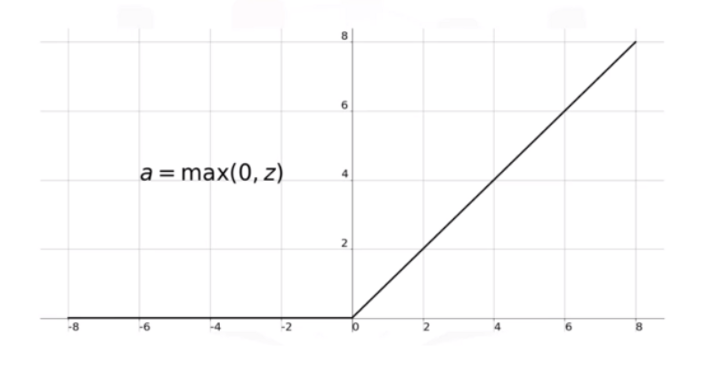
Dense Layer
Activation functions
model
related work
future work
introduction
limitations
cnn layers
result
Group Members
MD. MUZAKKER HOSSAIN 18-37801-2
ZAHIN AWOSAF 18-37064-1
MD. SALMAN HOSSAN PROTTOY 18-36902-1
ABU SALEH MUHAMMOD ALVY 18-37487-1
Softmax Function
ReLU Function

Slide 12
VGG16
MODEL
INPUT
CONV1_1
224X224X64
CONV1_2
224X224X64
MAXPOOL
224X224X3
MAXPOOL
112X112X64
CONV2_1
112X112X128
CONV2_2
112X112X128
56X56X128
CONV3_1
56X56X256
CONV3_2
56X56X256
CONV3_3
56X56X256
MAXPOOL
28X28X256
CONV4_1
28X28X512
CONV4_2
28X28X512
CONV4_3
28X28X512
MAXPOOL
14X14X512
CONV5_1
14X14X512
CONV5_2
14X14X512
CONV5_3
14X14X512
MAXPOOL
7X7X512
FC ReLU
1X1X4096
FC ReLU
1X1X4096
FC ReLU
1X1X1000
FC SOFTMAX (OUTPUT)
1X1X1000
DENSE ReLU
DROPOUT
DENSE_1 ReLU
NORM_1
512
512
NORM
512
512
256
256
DROPOUT_1
256
DENSE_2 ReLU
128
NORM_2
128
DROPOUT_2
128
SOFTMAX (OUTPUT)
43
INPUT
GLOBAL AVGPOOL
7X7X512
related work
model
future work
introduction
limitations
result
cnn layers
Group Members
MD. MUZAKKER HOSSAIN 18-37801-2
ZAHIN AWOSAF 18-37064-1
MD. SALMAN HOSSAN PROTTOY 18-36902-1
ABU SALEH MUHAMMOD ALVY 18-37487-1

Slide 13
VGG16 MODIFIED
MODEL PREPARED
INPUT
CONV1_1
224, 224, 64
CONV1_2
224, 224, 64
MAXPOOL
224X224X3
MAXPOOL
112X112X64
CONV2_1
112X112X128
CONV2_2
112X112X128
56X56X128
CONV3_1
56X56X256
CONV3_2
56X56X256
CONV3_3
56X56X256
MAXPOOL
28X28X256
CONV4_1
28X28X512
CONV4_2
28X28X512
CONV4_3
28X28X512
MAXPOOL
14X14X512
CONV5_1
14X14X512
CONV5_2
14X14X512
CONV5_3
14X14X512
MAXPOOL
7X7X512
DENSE ReLU
DROPOUT
DENSE_1 ReLU
NORM_1
7X7X512
512
NORM
512
512
256
256
DROPOUT_1
256
DENSE_2 ReLU
128
NORM_2
128
DROPOUT_2
128
SOFTMAX (OUTPUT)
43
GLOBAL AVGPOOL
related work
model
future work
introduction
limitations
result
cnn layers
Group Members
MD. MUZAKKER HOSSAIN 18-37801-2
ZAHIN AWOSAF 18-37064-1
MD. SALMAN HOSSAN PROTTOY 18-36902-1
ABU SALEH MUHAMMOD ALVY 18-37487-1

Slide 14
COMBINED MODEL
INPUT
CONV1_1
224, 224, 64
CONV1_2
224, 224, 64
MAXPOOL
224X224X3
MAXPOOL
112X112X64
CONV2_1
112X112X128
CONV2_2
112X112X128
56X56X128
CONV3_1
56X56X256
CONV3_2
56X56X256
CONV3_3
56X56X256
MAXPOOL
28X28X256
CONV4_1
28X28X512
CONV4_2
28X28X512
CONV4_3
28X28X512
MAXPOOL
14X14X512
CONV5_1
14X14X512
CONV5_2
14X14X512
CONV5_3
14X14X512
MAXPOOL
7X7X512
GLOBAL AVGPOOL
7X7X512
DENSE ReLU
512
NORM
512
DROPOUT
512
DENSE_1 ReLU
256
NORM_1
256
DROPOUT_1
256
DENSE_2 ReLU
128
NORM_2
128
DROPOUT_2
128
SOFTMAX (OUTPUT)
43
related work
model
future work
introduction
limitations
result
cnn layers
Group Members
MD. MUZAKKER HOSSAIN 18-37801-2
ZAHIN AWOSAF 18-37064-1
MD. SALMAN HOSSAN PROTTOY 18-36902-1
ABU SALEH MUHAMMOD ALVY 18-37487-1

Slide 15
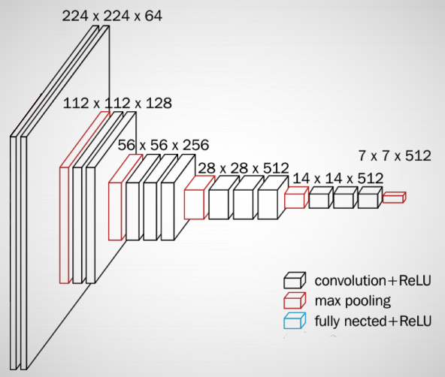
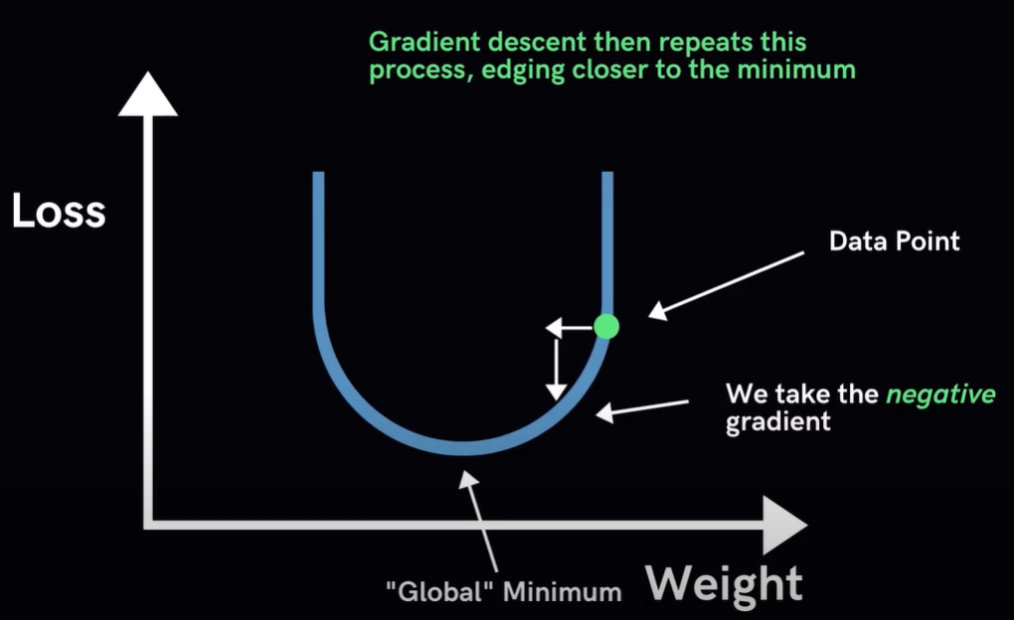
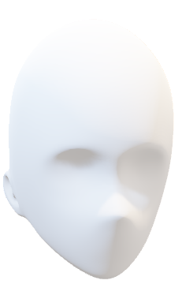
new_lr = lr * factor
VGG16 PRETRAINED
224x224x3
VGG16 pretrained model on ImageNet
Removed dense layer from vgg16
Combined model
INPUT
ImageNET
AVERAGE POOL
DENSE
BATCH NORMALIZATION
DROPOUT
DENSE
BATCH NORMALIZATION
DROPOUT
DENSE
BATCH NORMALIZATION
DROPOUT
OUTPUT
Frozen
related work
future work
introduction
limitations
model
result
cnn layers
Group Members
MD. MUZAKKER HOSSAIN 18-37801-2
ZAHIN AWOSAF 18-37064-1
MD. SALMAN HOSSAN PROTTOY 18-36902-1
ABU SALEH MUHAMMOD ALVY 18-37487-1
Factor 0.2
Learning rate= 1e-3
new_lr = lr * factor

Slide 16
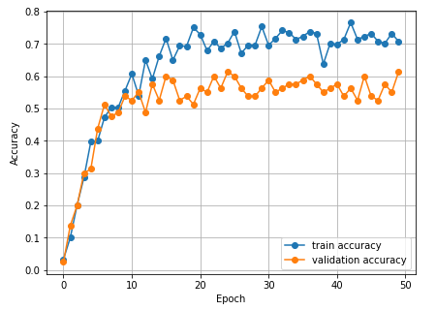
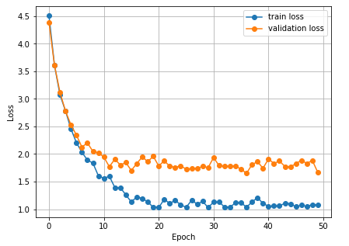
DATASET: 430 images belonging to 43 classes
Training: 344 images belonging to 43 classes.
Validation : 0.2% (86 images belonging to 43 classes)
ACCURACY: 61.125%
related work
model
future work
introduction
limitations
result
cnn layers
Group Members
MD. MUZAKKER HOSSAIN 18-37801-2
ZAHIN AWOSAF 18-37064-1
MD. SALMAN HOSSAN PROTTOY 18-36902-1
ABU SALEH MUHAMMOD ALVY 18-37487-1

Slide 17
The accuracy is modest, despite the use of fine-grained classification.
It is necessary to ensure that the face is visible.
Small dataset
related work
model
future work
limitations
introduction
result
cnn layers
Group Members
MD. MUZAKKER HOSSAIN 18-37801-2
ZAHIN AWOSAF 18-37064-1
MD. SALMAN HOSSAN PROTTOY 18-36902-1
ABU SALEH MUHAMMOD ALVY 18-37487-1

Slide 18
Future Work
Detect and recognize face from real time video feed.
Check for eye blinks
Use large dataset for higher accuracy
related work
model
future work
introduction
limitations
result
cnn layers
Group Members
MD. MUZAKKER HOSSAIN 18-37801-2
ZAHIN AWOSAF 18-37064-1
MD. SALMAN HOSSAN PROTTOY 18-36902-1
ABU SALEH MUHAMMOD ALVY 18-37487-1

Slide 19
Thank You
related work
model
future work
introduction
THE END
limitations
result
cnn layers
Group Members
MD. MUZAKKER HOSSAIN 18-37801-2
ZAHIN AWOSAF 18-37064-1
MD. SALMAN HOSSAN PROTTOY 18-36902-1
ABU SALEH MUHAMMOD ALVY 18-37487-1

